Slide 1
INTRODUCTION TO ACID MINE DRAINAGE
Created By:
Appalachian Watershed Research Group
The Voinovich School of Leadership & Public Affairs
Ohio University
A special thanks to the AEP Foundation!

Slide 2
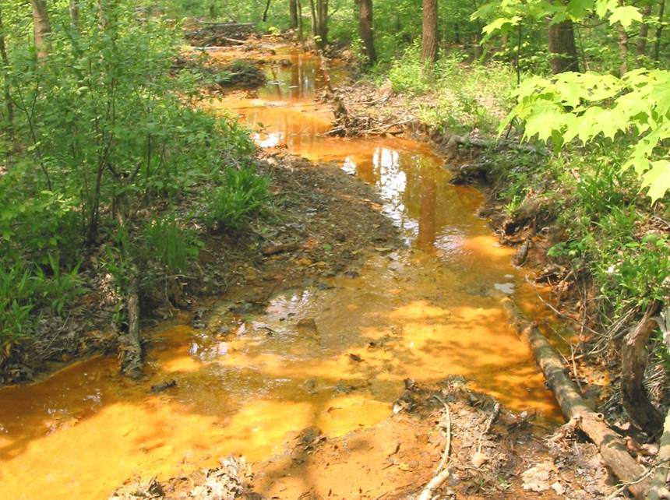
http://www.raccooncreek.org/about-the-watershed/stream-health/

Slide 3
WHAT IS ACID MINE DRAINAGE?

Slide 4
WHAT CAUSES ACID MINE DRAINAGE?

Slide 5
WHAT ARE THE EFFECTS OF ACID MINE DRAINAGE?

Slide 6
WHY SHOULD YOU CARE ABOUT ACID MINE DRAINAGE?

Slide 7
What is Acid Mine Drainage?
Acid mine drainage (AMD) is the result of a chemical reaction between oxygen and sulfate compounds.
When water flows through a mine or a pile of mine waste, it reacts with the rock, creating a high-acidity solution with a high concentration of heavy metals.
A non-point source pollution
watersheddata.com

Slide 8
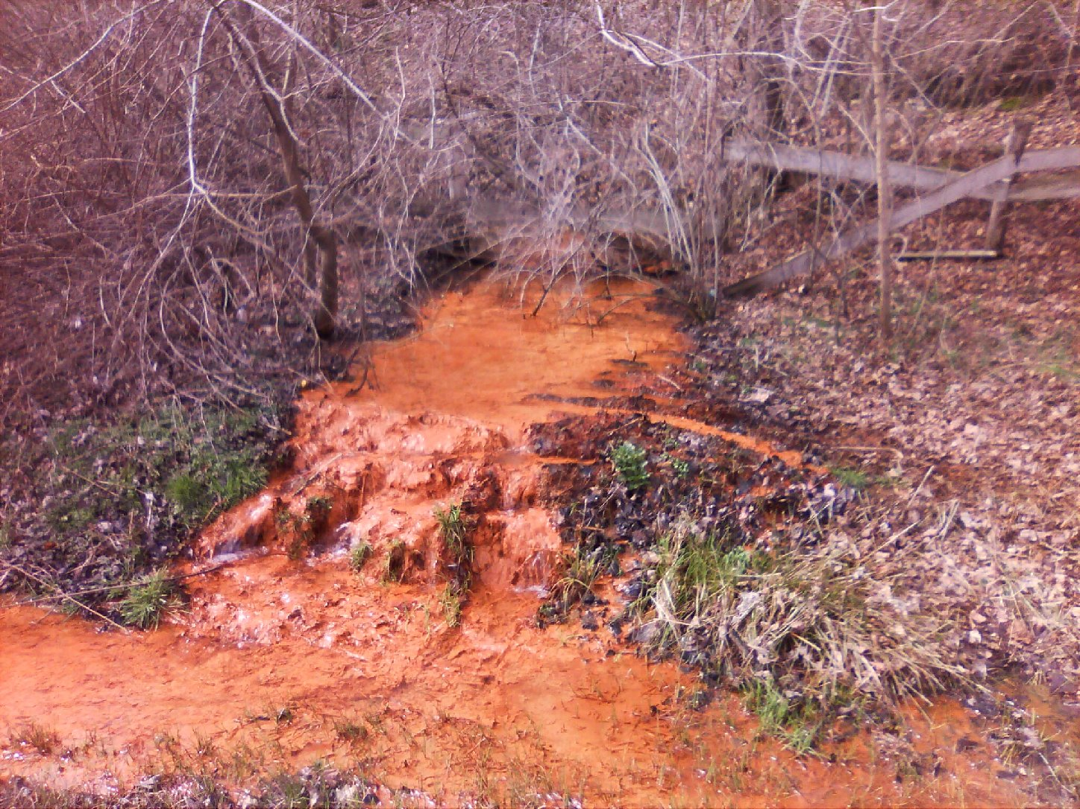
ww2.kqed.org

Slide 9
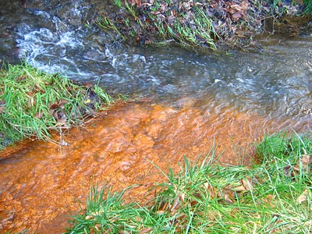
www.wmmt.org

Slide 10
What Causes Acid Mine Drainage?
When the mining process of metal ores exposes sulfide rich minerals to water and air, together they react to form sulfuric acid
This acid can dissolve other harmful metals and metalloids (like arsenic) from the surrounding rock
Acid mine drainage can be released anywhere in the mine where sulfides are exposed to air and water- including waste rock piles, tailings, open pits underground tunnels, and leach pads
Earthworksaction.org

Slide 11
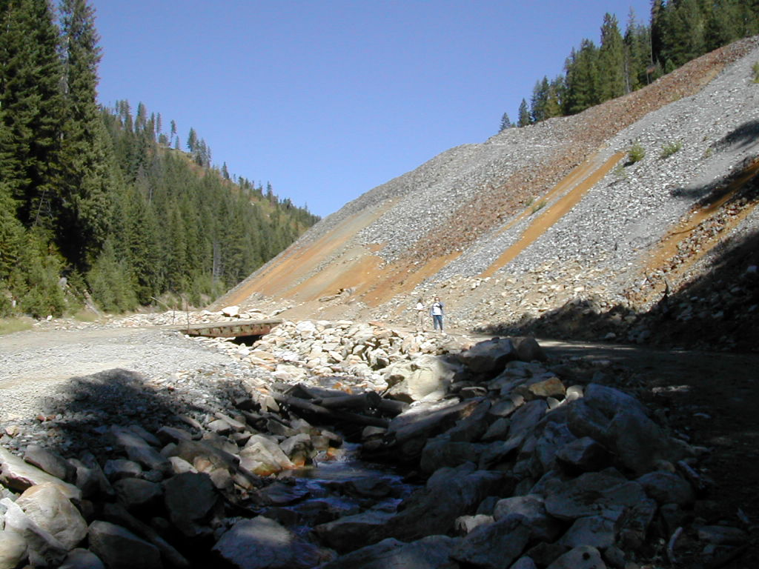
www.forbes.com

Slide 12
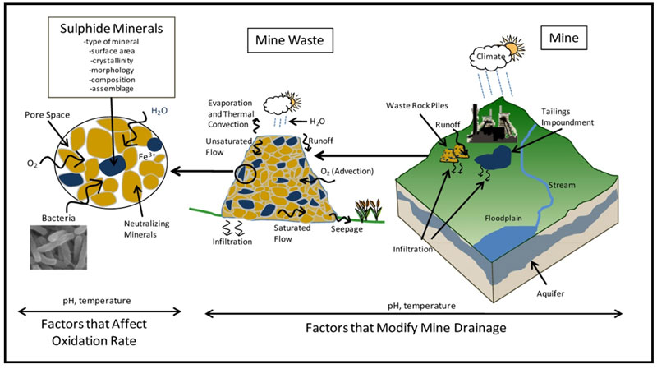
www.gardguide.com

Slide 13
What are the Effects of Acid Mine Drainage?
Degraded water quality
Loss of biodiversity
Heavy metal sedimentation
Human health impacts (increased cancer rates, dermatitis, lung damage, tooth decay)
Contaminated drinking water
Economic inequality

Slide 14
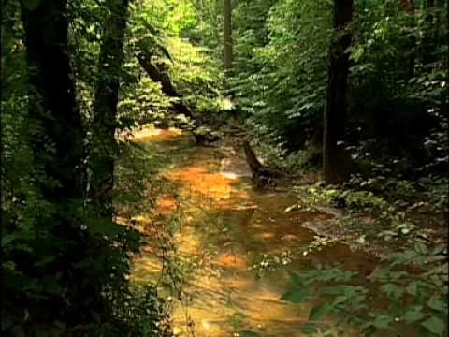
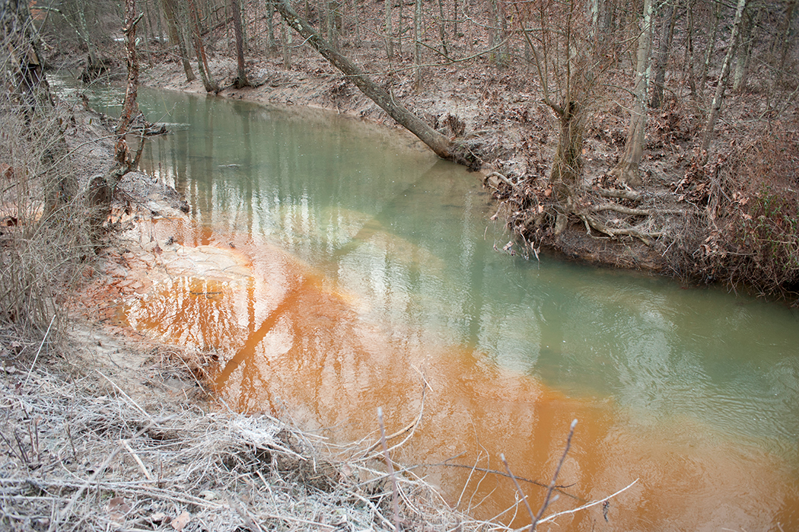
Why Should You Care About Acid Mine Drainage?
Acid Mine Drainage occurs in streams all around the globe
INCLUDING MANY STREAMS HERE IN SOUTHEAST OHIO!
article.wn.com
www.ohio.edu

Slide 15
Exit Ticket
On a sheet a paper, answer the following questions in your own words.
Be sure to use a complete sentence!
What is Acid Mine Drainage (AMD)
What causes AMD?
What are the effects of AMD?
Why should we care about AMD?

Slide 16
Watersheddata.com
Hover over “Surface Water”
Select “Raccoon Creek”
Search by Site ID (ex HF137)
Under “Site” tab
Mile Marker= river mile (x)
Under “Chem Data” tab
Click “view” for sample data 9/16/2015
Find and Record your parameter (y)

Slide 17
Creating Your Graph
**YOUR X VALUES MUST BE RECORDED FROM GREATEST TO LEAST**
Parameter
Miles Downstream

Slide 18
Discussion Questions
The graphs for ALL parameters experience a spike at site HF 190. Can you suggest an explanation?
Why don’t these parameters remain constant throughout the stream?
Which of these parameters are related to each other?

Slide 19
Write…
… one paragraph explaining changes in parameters along stream. Please include examples of what the changes are and reasons why those changes occur. Please also describe connections between different parameters.

Slide 20
Special Thanks To:
Appalachian Watershed Research Group
The Voinovich School of Leadership & Public Affairs
Ohio University
AEP Foundation

